Slide 1
Lecture 0: Course Overview & Introduction to Serological Concepts and Methods
21 May 2025
Seroanalytics Training Blantyre, Malawi

Slide 2








Welcome from the instructor team!
Sonia
Hegde
(JHU)
Sophie
Berube
(Florida)
Sarah
Lapidus
(JHU)
Alyssa
Sbarra
(JHU)
Megan
O’Driscoll
(Geneva)
Mika
Malouf
(LSHTM)
Upendo
Mseka
(MLW)
Cebile
Lekhuleni
(NICD)

Slide 3
Goals of the course
To learn the core concepts to pre-process, visualize, analyze, and interpret serological data.
To learn the applied techniques to conduct the above steps using R.
To apply learnings to participants’ own research questions and data sets.
To build a network with other participants from around the world who are also conducting serological data analyses.

Slide 4
Course Overview
Lecture 1 & Lab 1: Introduction to R for serological data analyses
Lecture 2 & Lab 2: Pre-processing serological data
Lecture 3 & Lab 3: Visualizations for serological data
Lecture 4 & Lab 4: Determining serostatus and estimating seroprevalence
Lecture 5 & Lab 5: From serological data to transmission dynamics
+ Time to work on individual projects
+ Seminars on advanced topics

Slide 5
Traditional surveillance data may provide an incomplete picture of transmission and disease burden
Existence of asymptomatic or sub-clinical infections
Incomplete understanding of factors leading to symptomatic disease
Differences in testing and reporting practices between and within locations, and over time
These may be complicated by immunity

Slide 6
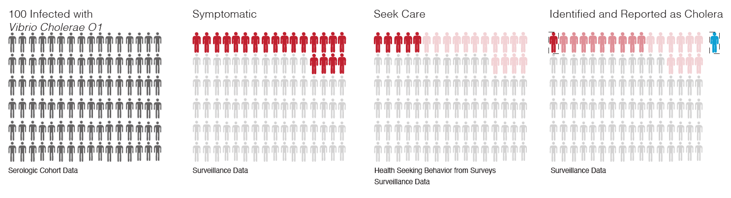
Disease burden estimation largely relies on clinical surveillance
Infections
Symptomatic
Seek care
Identified and reported
Notes:
Cholera burden estimation largely relies on passive clinical based surveillance which only captures a fraction of true infections due to variable clinical presentations and access to healthcare
This is the paradigm or cascade of how we capture true burden
Add icon to indicate serology, healthcare seeking, clinical burden
(or consider iceberg figure)

Slide 7
Disease burden estimation largely relies on clinical surveillance
Infections
Symptomatic
Seek care
Identified and reported
Notes:
Cholera burden estimation largely relies on passive clinical based surveillance which only captures a fraction of true infections due to variable clinical presentations and access to healthcare
This is the paradigm or cascade of how we capture true burden
Add icon to indicate serology, healthcare seeking, clinical burden
(or consider iceberg figure)

Slide 8
Disease burden estimation largely relies on clinical surveillance
Infections
Symptomatic
Seek care
Identified and reported
Notes:
Cholera burden estimation largely relies on passive clinical based surveillance which only captures a fraction of true infections due to variable clinical presentations and access to healthcare
This is the paradigm or cascade of how we capture true burden
Add icon to indicate serology, healthcare seeking, clinical burden
(or consider iceberg figure)

Slide 9
Disease burden estimation largely relies on clinical surveillance
Infections
Symptomatic
Seek care
Identified and reported
Notes:
Cholera burden estimation largely relies on passive clinical based surveillance which only captures a fraction of true infections due to variable clinical presentations and access to healthcare
This is the paradigm or cascade of how we capture true burden
Add icon to indicate serology, healthcare seeking, clinical burden
(or consider iceberg figure)

Slide 10
Use cases of serology at individual and population levels
At the individual level:
To indirectly diagnose recent or prior infection
To hypothetically ascertain who is protected
e.g., screening health care workers for measles antibody titers
To measure as a surrogate outcome in vaccine trials
At the population level:
To quantify cumulative incidence or immunity in a population (Lecture 4)
To obtain biomarkers of additional metrics
e.g., recency or frequency of exposures (using quantitative responses)
To parametrize mechanistic transmission models

Slide 11

Serology is the gold standard to quantify infections in a population
Antibodies allow for estimation of key disease transmission parameters
Natural history: case-ascertainment ratio, infection-fatality ratio
Epidemiology: attack rate, R0, force of infection (Lecture 5)
However, this requires having an appropriate serological assay and adequate interpretation.
Deaths
Severe cases
Symptomatic
Mild cases
Asymptomatic

Slide 12
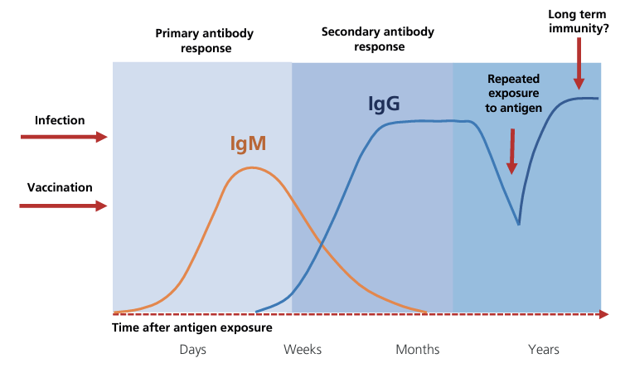
Kinetics of the antibody response: for this course, we focus on IgG

Slide 13
There are many public health use cases of sero-epidemiology
Use Case | Example Pathogens
1. Burden and distribution of infections | Campylobacter, Chagas, chikungunya, cholera, Cryptosporidium, cysticercosis, Giardia, neglected tropical diseases, Plasmodium species (some), strongyloidiasis, yaws, HIV
2. Identification of emerging and re-emerging infections | Ebola, Lassa, Marburg, Mpox, SARS-CoV-2, Zika
3. Identification of vaccine program reach or gaps | Measles, polio, rubella, SARS-CoV-2, yellow fever
4. Assessing infection changes due to behavioral, environmental, or pharmaceutical interventions or environmental changes | Chikungunya, dengue, malaria, PCV13 (must be able to distinguish between vaccine- and infection-derived immunity), Typhoid
5. Monitoring peri- and post-elimination surveillance settings | Guinea worm, human African trypanosomiasis, Lymphatic filariasis, malaria (sub-national levels), onchocerciasis, trachoma, visceral leishmaniasis, yaws
6. Research | Many!
1st Serosurveillance Summit meeting report, March 2023

Slide 14
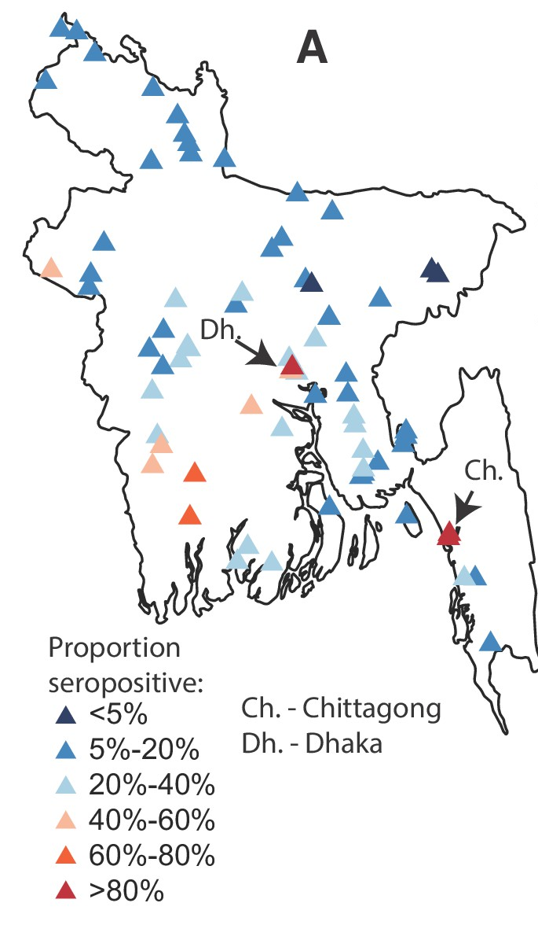
Use case 1: Burden and distribution of infections
Dengue in Bangladesh
Fills gaps in existing surveillance systems
Identifies population levels of susceptibility or immunity
Provides “true” number and distribution of infections
Particularly useful for diseases with asymptomatic or mild infections, poor diagnostics for acute infections, and areas where there is poor access to care
Salje, et al. eLife (2019)

Slide 15
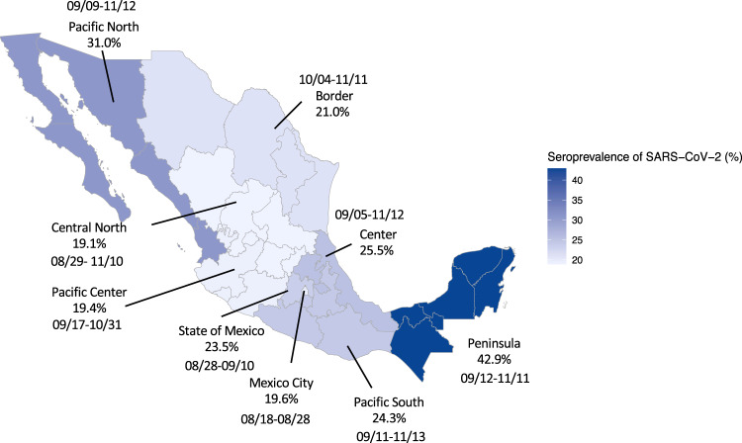
Use case 2: Identification of emerging and re-emerging infections
SARS-CoV-2 in Mexico
Allows identification of previously undetected infections
Tracks outbreaks
Monitors changes in types or magnitude of response required
Basto-Abreu, et al. Nat Comm (2022)
Notes:
Example on the right is tracking SARS-CoV-2 seroprevalence during the first year of the pandemic in Mexico

Slide 16
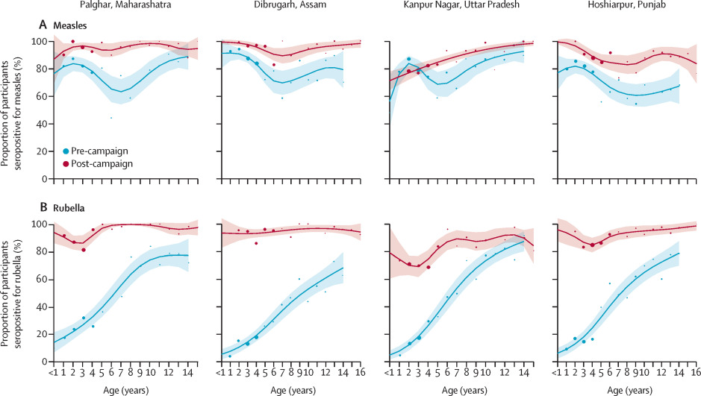
Use case 3: Identification of vaccine program reach or gaps
Geographic and demographic reach of vaccination or gaps in vaccination can be used:
To determine age of first routine vaccination
To estimate routine vaccination coverage
To identify the need for a vaccination campaign
To evaluate the impact of a vaccination campaign
Measles and Rubella in India
Murhekar, et al. Lancet Glob Health (2022)
Notes:
Example on the right is from India Measles and rubella seroprevalence before and after vaccination campaigns

Slide 17
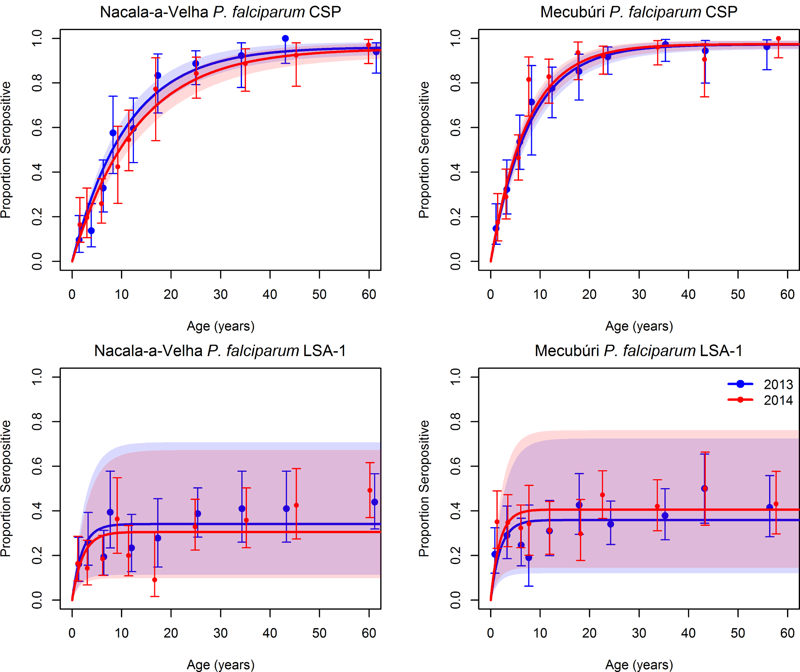
Use case 4: Assessing effectiveness of behavioral, environmental or pharmaceutical interventions
Malaria in Mozambique
Evaluates the effect of interventions other than vaccination (e.g., bed nets, water, sanitation and hygiene interventions)
However, IgG may not always be the best way to measure changes for some interventions – e.g., antibiotics
Plucinski, et al. PLoS Negl Trop Dis (2018)
Notes:
Righthand example is the Impact of bed net distribution on malaria seroprevalence in Mozambique. Blue is before and red is afterward.

Slide 18
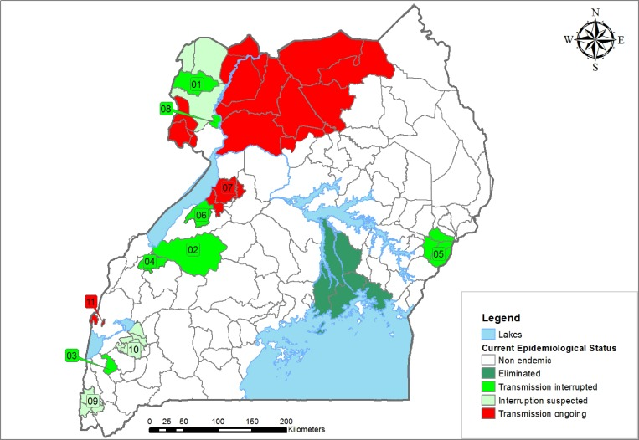
Use case 5: Monitoring peri- and post-elimination surveillance settings
Onchocerciasis in Uganda
Diseases where elimination of transmission is the target
Can be used for validation of elimination as well, such as for NTDs
Monitoring to ensure no re-emergence of disease
Oguttu, et al. AJTMH (2014)
Notes:
On the right is an example monitoring onchocerciasis elimination in Uganda

Slide 19
What is the promise of multiplex serology?
Multiplex serology enables:
Simultaneous estimation of antibody prevalence for multiple pathogens (i.e., maximizes specimen efficiency)
Lower marginal testing cost and time (i.e., easy to include pathogens not routinely surveilled)
Notes:
New technologies allow multiplexing to test one single specimen for dozens of antibodies simultaneously, maximizing the efficiency. By testing everything at once, this minimizes the use of reagents and laboratory staff time. It also makes it possible to include additional antigens that might not otherwise have been included if they are obscure.

Slide 20
What are the use cases of multiplex serosurveillance?
To identify geographic areas that have high exposure to multiple pathogens or low coverage to multiple vaccine preventable diseases (to inform surveillance systems, programmatic decision-making, and horizontally aligned interventions like WASH, vaccines)
To identify vulnerable sub-populations (e.g., immunity to measles among people living with HIV)
To more accurately monitor intervention effectiveness by measuring serological responses to multiple antigens from a single pathogen
To estimate exposure history for pathogens that exhibit cross-reactivity with increased specificity, by simultaneously measuring serological responses to antigens from cross-reacting pathogens
Notes:
New technologies allow multiplexing to test one single specimen for dozens of antibodies simultaneously, maximizing the efficiency. By testing everything at once, this minimizes the use of reagents and laboratory staff time. It also makes it possible to include additional antigens that might not otherwise have been included if they are obscure.

Slide 21
Study designs commonly used in seroepidemiology
Cross-sectional serosurvey (single or serial)
Longitudinal cohort study

Slide 22




Slide 23
Sero-prevalence: single cross-sectional study

Slide 24
Attack rate (serial cross-sectional, or longitudinal cohort)

Slide 25
Longitudinal antibody dynamics

Slide 26

Pre- and post-infection antibody dynamics
Pre Day 0 Post t₁ Post t₂

Slide 27
Laboratory assays commonly used in seroepidemiology
Serological assays commonly used for serosurveillance and for research
Enzyme immunoassays (EIA, ELISA)
Multiplex bead assays (MBA; e.g., Luminex)
Electrochemiluminescence assays (ECL; e.g., MSD)
(Hem)agglutination (inhibition) assays (HI/HAI)**
Neutralization assays** (e.g., vibriocidal for cholera)
**Functional assays
Serological assays used for research
Protein microarrays
Phage display
...

Slide 28
Laboratory assays commonly used in seroepidemiology
Serological assays commonly used for serosurveillance and for research
Enzyme immunoassays (EIA, ELISA)
Multiplex bead assays (MBA; e.g., Luminex)
Electrochemiluminescence assays (ECL; e.g., MSD)
(Hem)agglutination (inhibition) assays (HI/HAI)**
Neutralization assays** (e.g., vibriocidal for cholera)
**Functional assays
Serological assays used for research
Protein microarrays
Phage display
...

Slide 29
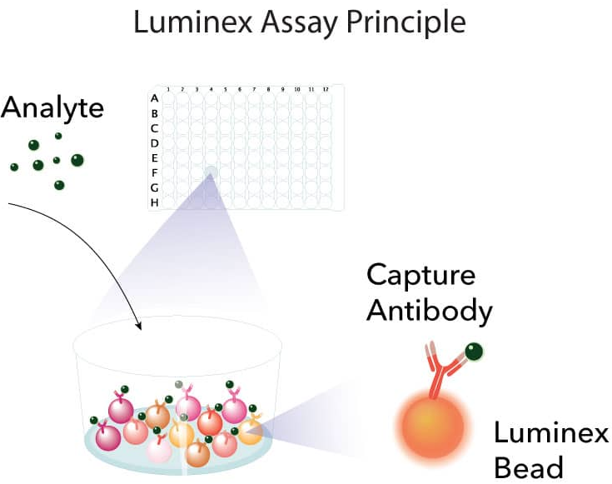
Multiplex bead assays (MBAs) produce median fluorescence intensity (MFI) values
MFI is a morphological measurement
Raw MFIs contain biological and technical variation
Biological variability:
Differences across samples (natural person-to-person variability)
Differences across disease condition
‘Chemical’ variability:
Cross-reactivity or chemical interference with binding
Presence of tags (e.g. GST) interfering with binding
Laboratory variability:
Sample and reagent storage
Time since last machine calibration, maintenance, cleaning
Pipetting precision
We will discuss this in Lecture 2

Slide 30
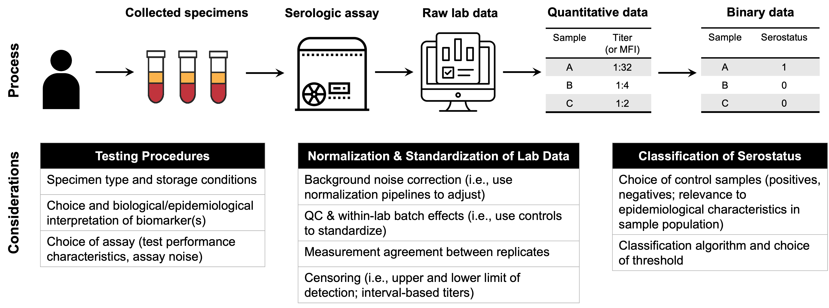
From blood vials to seroepidemiological data
Hay, Routledge, Takahashi. Epidemics (2024)

Slide 31

What we’ll cover in this course
Epidemiologic inference
Transmission dynamics
Data visualization & interpretation
Estimating relevant parameters
Estimating population seroprevalence (or seroincidence) and associated uncertainty
Inferring transmission dynamics (force of infection)
Data sharing
Visualize data to better inform inference
Present and interpret results for policy-relevant decision making

Slide 32
What we’ll cover in this course
Epidemiologic inference
Transmission dynamics
Data visualization & interpretation
Estimating relevant parameters
Estimating population seroprevalence (or seroincidence) and associated uncertainty
Inferring transmission dynamics (force of infection)
Communicating data
Visualize data to better inform inference
Present and interpret results for policy-relevant decision making
We will not be covering study design in the lectures (e.g., sample size calculation)

Slide 33
Course Overview
Lecture 1 & Lab 1: Introduction to R for serological data analyses
Lecture 2 & Lab 2: Pre-processing serological data
Lecture 3 & Lab 3: Visualizations for serological data
Lecture 4 & Lab 4: Determining serostatus and estimating seroprevalence
Lecture 5 & Lab 5: From serological data to transmission dynamics
+ Time to work on individual projects
+ Seminars on advanced topics

